Slide 1
Job Management & Tracking System (JMTS)
Now and the Future

Slide 2
Contents
What is it?
Current Features
Features being updated or developed
Screenshots
Development Methodology
The Future

Slide 3
What is it?
An Enterprise Resource Planning (ERP) software
Tailored for standards, certification and regulatory organizations
A common database that supports all software modules
Support for multiple organizations with separate business entities such as clients
Partially integrated with popular accounting software

Slide 4
Current Features
Advance job management features
Limited job status and tracking features
Complete job costing features
Partially complete system-wide configuration and management features
Existing Legal Office database application included as a module
Inactive and incomplete alerts and notification system
Inadequate management and other reports

Slide 5
Features being updated or developed
Updated job management and tracking features with alerts and notifications
Additional software modules to meet standards, certification and regulatory needs (see screenshots)
Enhanced system administration features (see screenshots)
Over 20 job related and other reports

Slide 6
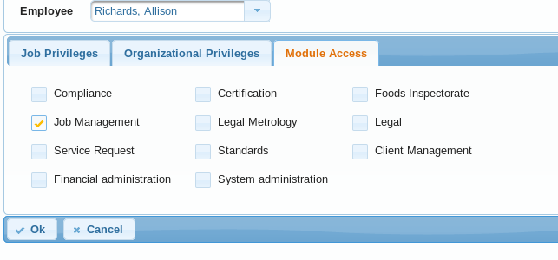
Screenshots
A System Administrator can grant access to the required modules

Slide 7
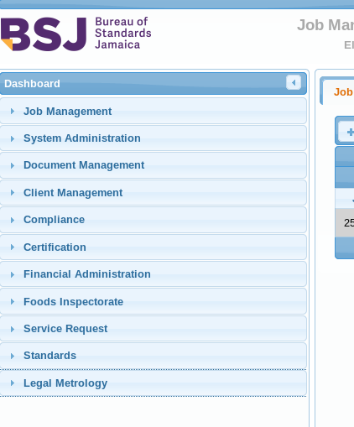
Screenshots (continued)
The Dashboard shows the modules to which a user has been granted access

Slide 8
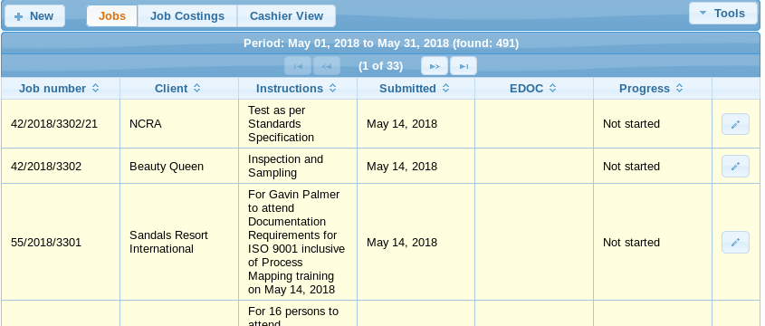
Screenshots (continued)
Three views are provided to allow the results of a job search to be viewed according to the user’s needs

Slide 9
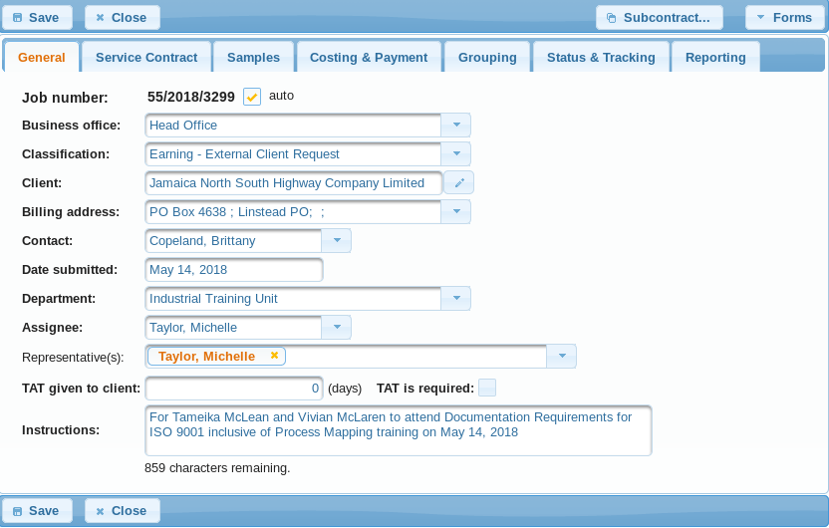
Screenshots (continued)
The detail of a job is grouped into tabs for easy location of information

Slide 10
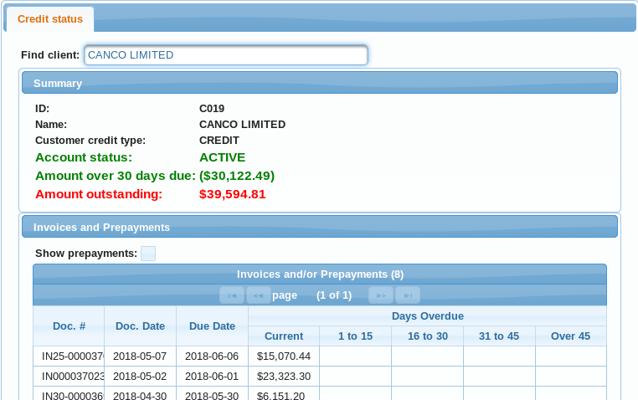
Screenshots (continued)
Integration with the enterprise’s accounting software allows the credit status of a client to be determined

Slide 11
Development Methodology
Process mapping and requirements gathering
Agile methodology for software development
Unit (with JUnit) and User Acceptance Testing (UAT)
Continuous incremental development and deployments
User feedback and from beta version releases
Web application security assessment

Slide 12
The Future
Cloud-based deployments to facilitate use by any organization that requires the services of the JMTS
Used by standards, certification and regulatory organizations in the Caribbean
Integration with other software such as web applications, websites, Content Management Systems and ERPs to enhance the features
Development of “light” desktop and mobile versions of the JMTS for field use

